Slide 1
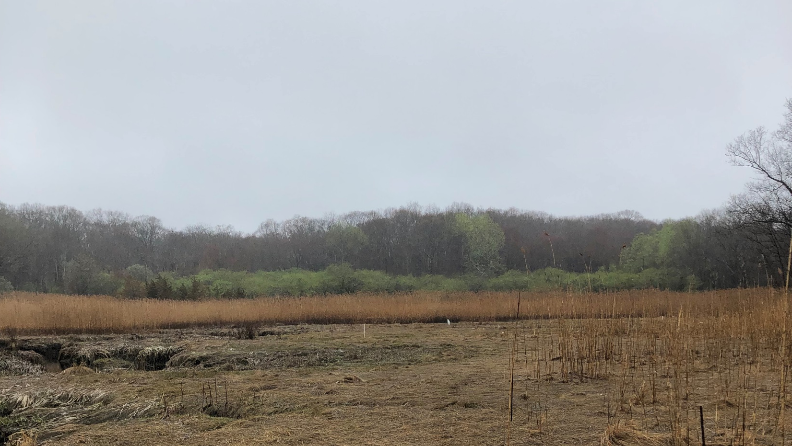

Analyzing Mass Audubon’s Salt Marsh Science Project Data

Slide 2
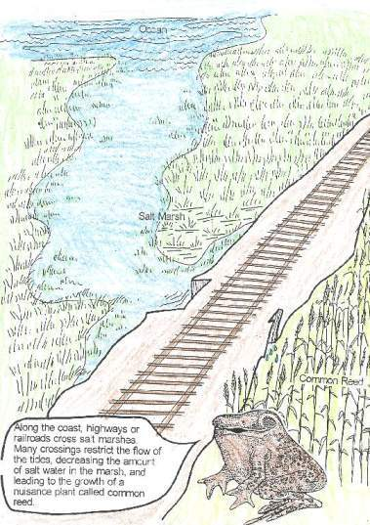
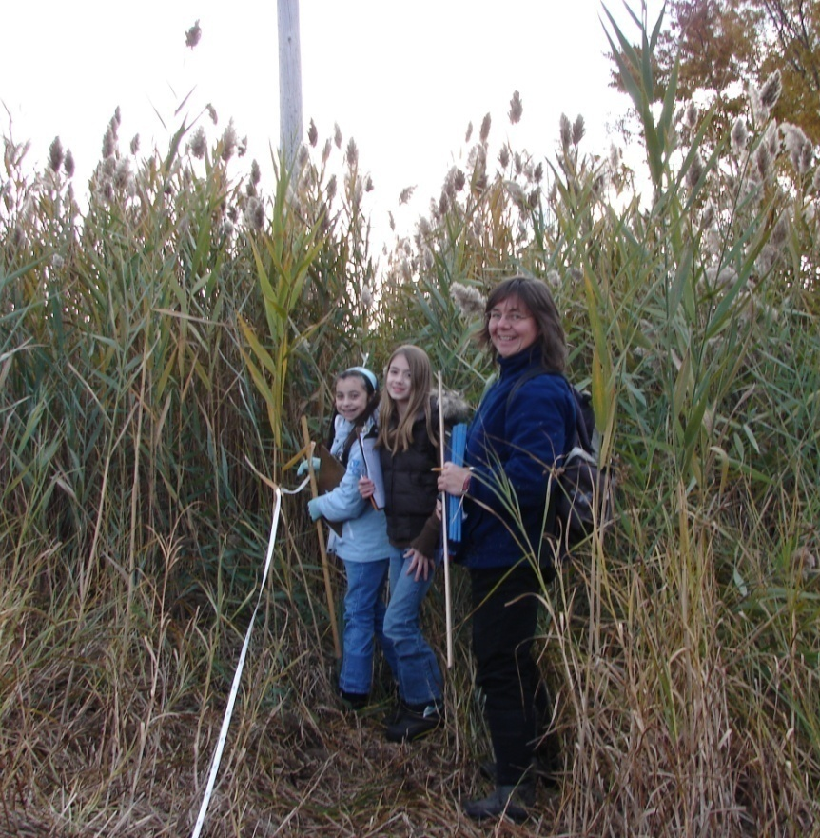
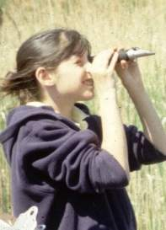
Primary Focus: Investigating the invasive reed Phragmites and salinity (how salty the water is)

Slide 3
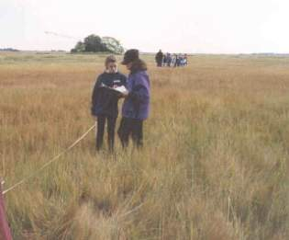
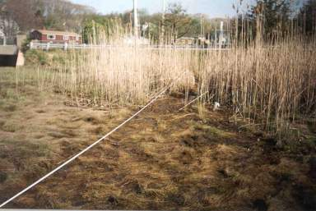
Some of our Questions:
Is Phragmites spreading?
Is Phragmites responding to restoration efforts?
How does that correlate with salinity levels?
Where is Phragmites thriving?
Where is Phragmites stressed

Slide 4

Our Hypotheses
Phragmites prefers water with lower salinity, and has a harder time growing in salinities > 20ppt (Rozsa 1995)
Phragmites would grow taller in areas with lower salinity.
Shorter stands of Phragmites indicated salinity stress
Phragmites would respond to increased tidal flow by decreasing in height and retreating along the transects

Slide 5
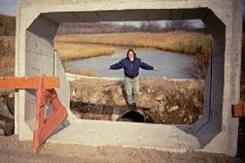
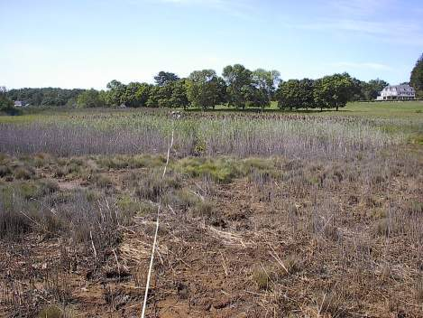
Restoration of Salt Marshes:
Restored Tidal Flow by
Opening tide gates
Increasing culvert size
Argilla Road, Ipswich Salt Marsh was restored in 1997
Phragmites retreated

Slide 6
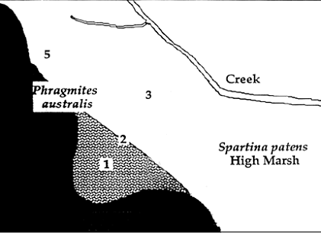
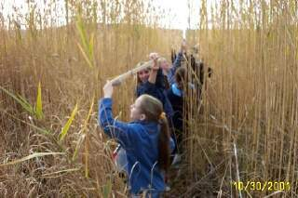
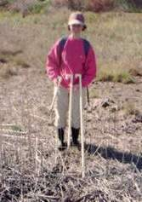
25
0
Phragmites and Salinity Methodology
Notes:
We measure salinity at three different depths
in 3 locations on the marsh.
We record the presence of plants, and measure
Phragmites heights along a 25 meter transect
Return to the same exact locations each year.

Slide 7
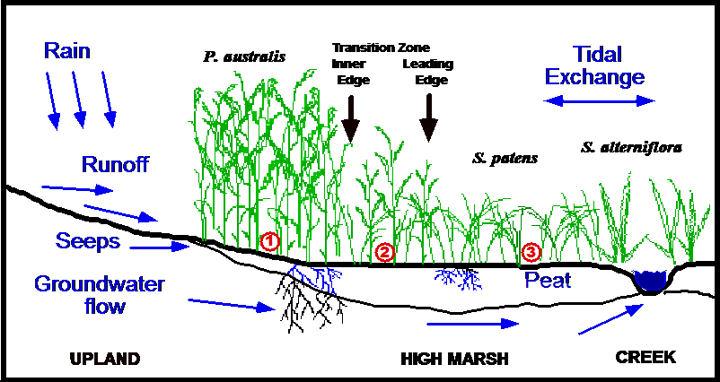
How does the water cycle and the tide cycle impact salinity levels?
Predict: where will salinity be the highest: Site 1, 2, or 3?
Graphic by David M. Burdick Jackson Estuarine Laboratory Department of Natural Resources University of New Hampshire
Notes:
Salt water is denser than fresh water, so, we might expect the deepest well to therefore have the greatest salinity. However, the water cycle also has an impact. The shallow well seems to change the most seasonally. In the spring, following a lot of rain and snowmelt, the shallow well often has the lowest salinity. However in the fall, following a lot of evaporation during the summer, the shallow well often has the highest salinity. Evaporation increases salinity, as water evaporates, leaving more concentrated salt. Precipitation decreases salinity, as increased water dilutes the salt.

Slide 8
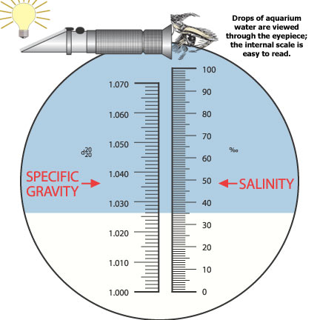
How to read a refractometer
Read on the right side of the refractometer.
⁰/₀₀ means parts per thousand (ppt)
http://www.drsfostersmith.com/pic/article.cfm?aid=769

Slide 9
Salinity Scale

Slide 10
Phragmites Height Scale

Slide 11

Is the salt marsh healthier now that we have restored tidal flow?
Check the things below that would indicate a healthier salt marsh:
Higher salinity ____________ Lower salinity __________________
More invasive species _________ Less invasive species ___________
Taller Phragmites _____________ Shorter Phragmites ____________
More native plants _________ Less native plants _____________
More wet, dead areas __________ Less wet, dead areas ____________
Hypothesis: Replacing the culvert (pipe under the road) would lead to reduced Phragmites, and improve the health of the marsh.
Does the data support this hypothesis?
What evidence do you see? (If the data gives mixed results, please describe.)

Slide 12

Is the Salt Marsh Healthier now that we have restored tidal flow?
Mass Audubon Scientists think the things below would indicate a healthier salt marsh:
Higher salinity _____x_______ Lower salinity __________________
More invasive species _________ Less invasive species _____x______
Taller Phragmites _____________ Shorter Phragmites _____x_______
More native plants ____x_____ Less native plants _____________
More wet, dead areas __________ Less wet, dead areas _____x_______
Hypothesis: Replacing the culvert (pipe under the road) would lead to reduced Phragmites, and improve the health of the marsh.
Does the data support this hypothesis?
What evidence do you see? (If the data gives mixed results, please describe.)

Slide 13

Pause to analyze data
For the most current data, go to www.massaudubon.org/saltmarsh

Slide 14
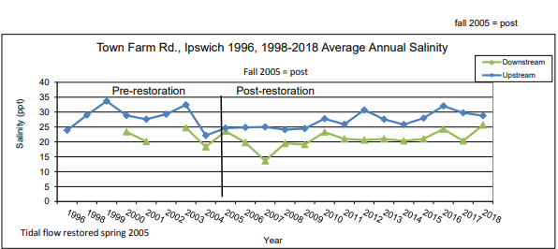

Slide 15
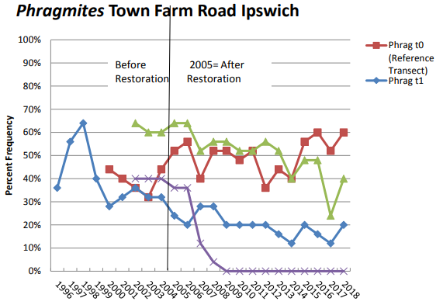

Slide 16
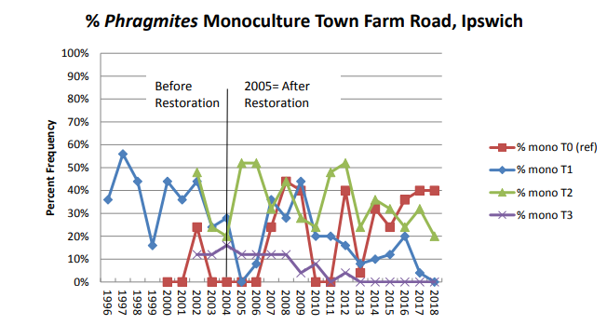
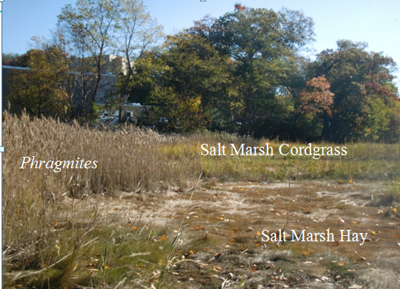

Slide 17
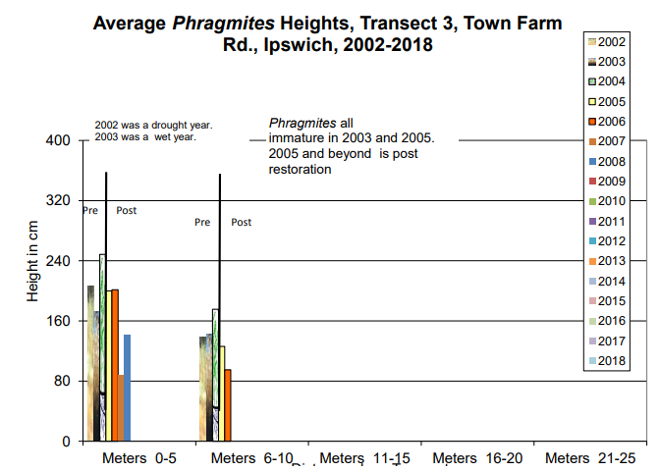
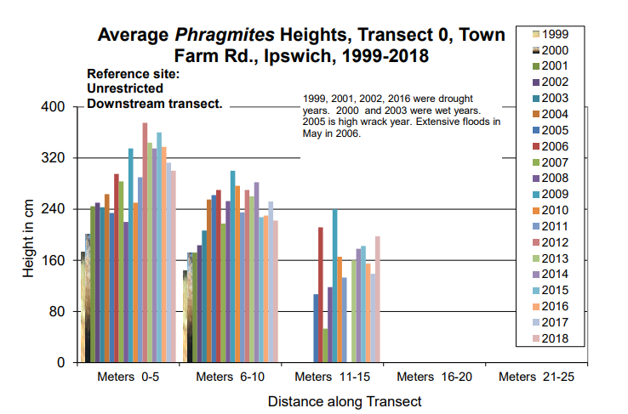

Slide 18
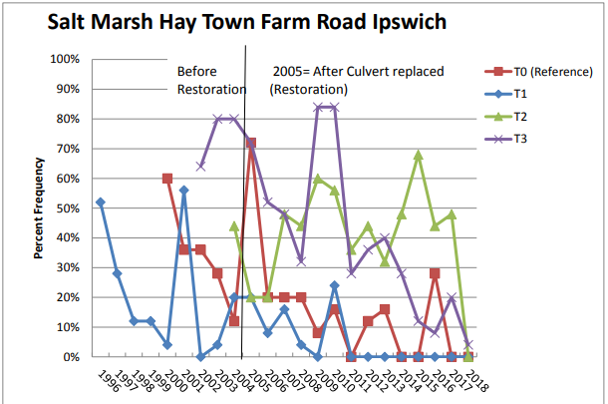

Slide 19
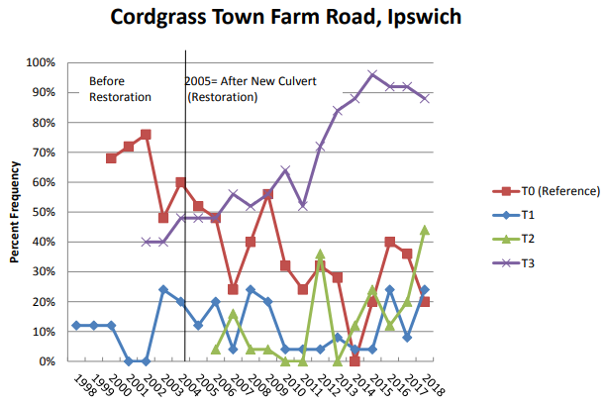

Slide 20
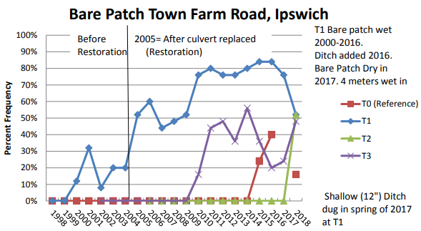

Slide 21
New Question: Sea Level Rise

Slide 22
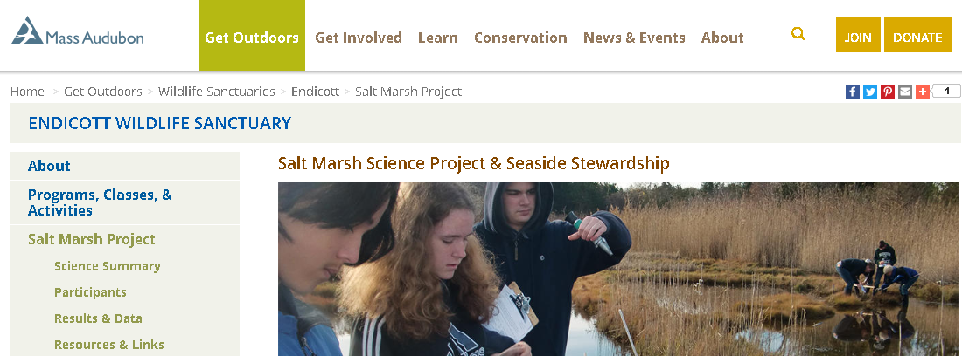
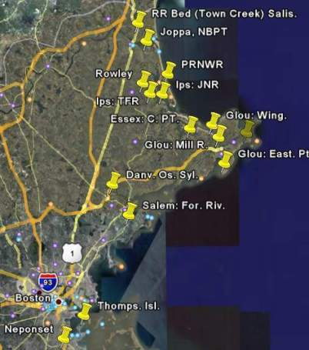
Salt Marsh Science Website Holds the Most Recent Data
www.massaudubon.org/saltmarsh

